Slide 1

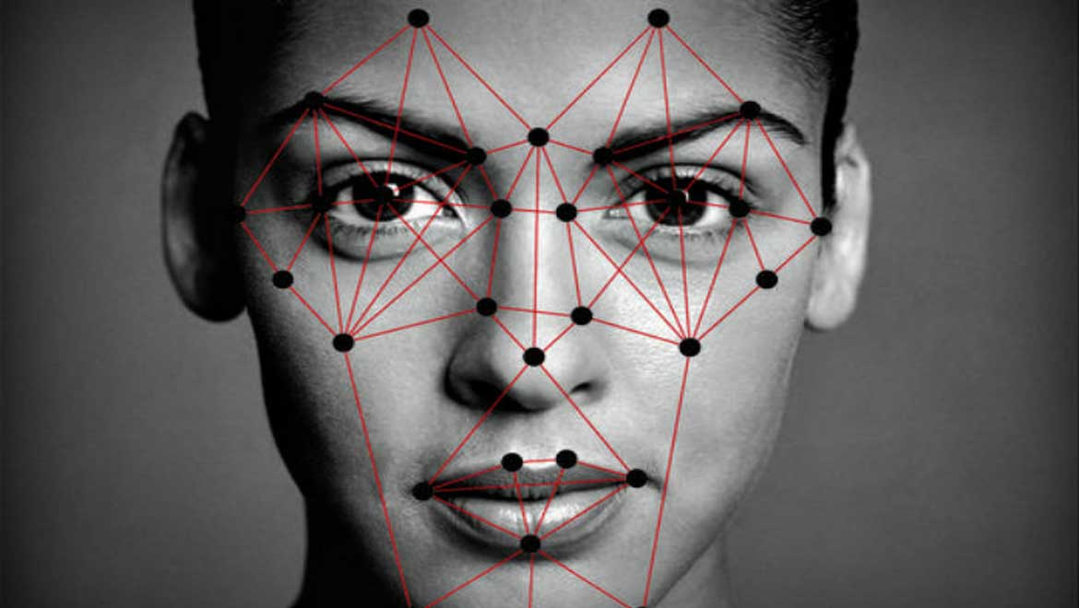
FACE RECOGNITION-TRACKING ATTENDENCE

Slide 2

AGENDA
*INTRODUCTION
*Abstract
*Face recognition
*Advantages/disadvantages
*Implementation of project
*Conclusion

Slide 3

INTRODUCTION
Face recognition-based attendance system is a process of recognizing the students face for taking attendance by using face biometrics based on high - definition monitor video and other information technology. Traditionally, student’s attendances are taken manually by using attendance sheet given by the faculty in class, which is a time consuming event. Moreover, it is very difficult to verify one by one student in a large classroom environment with distributed branches whether the authenticated students are actually responding or not. FACE RECOGNITION technology is gradually evolving to a universal biometric solution since it requires virtually zero effort from the user end while compared with other biometric options. It is accurate and allows for high enrolment and verification rates

Slide 4
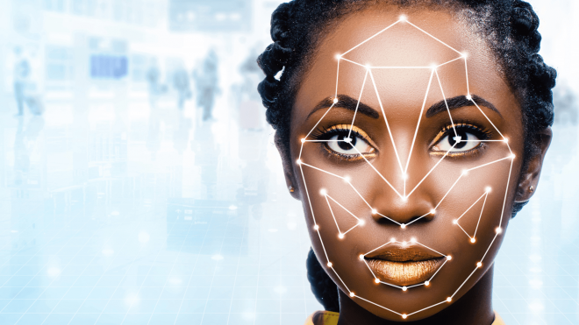
Face recognition
*Facial recognition is a way of identifying or confirming an individual’s identity using their face. Facial recognition systems can be used to identify people in photos, videos, or in real-time.
*Facial recognition is a category of biometric security.
*Other forms of biometric software include voice recognition, fingerprint recognition, and eye retina or iris recognition.
WORKING OF FACE RECOGNITION:
Step 1: Face detection
Step 2: Face analysis
Step 3: Converting the image to data
Step 4: Finding a match

Slide 5
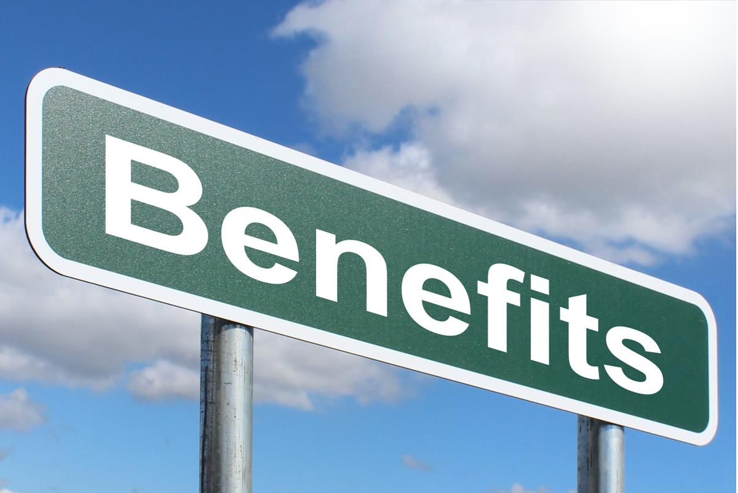
ADVANTAGES
Facial recognition is a technology that can benefit society, including increasing safety and security, preventing crimes, and reducing human interaction. Here are some pros of facial recognition:
Helps find missing people
Protects businesses against theft
Improves medical treatment
Strengthens security measures
Makes shopping more efficient
Reduces the number of touchpoints
Improves photo organization

Slide 6

DISADVANTAGES
Facial recognition is an innovative technology that has the power to change our future. However, like any innovation, some consequences and risks are involved when implementing this new system in society.
Threatens privacy
Imposes on personal freedom
Violates personal rights
Data vulnerabilities
Misuse causing fraud and other crimes
Technology is still new
Errors can implicate innocent people
Technology can be manipulated

Slide 7

ABSTRACT
The management of the attendance can be a great burden on the teachers if it is done by hand. To resolve this problem, smart and auto attendance management system is being utilized. By utilizing this framework, the problem of proxies and students being marked present even though they are not physically present can easily be solved. This system marks the attendance using live video stream. The frames are extracted from video using OpenCV. The main implementation steps used in this type of system are face detection and recognizing the detected face, for which dlib is used. After these, the connection of recognized faces ought to be conceivable by comparing with the database containing student's faces. This model will be a successful technique to manage the attendance of students.

Slide 8
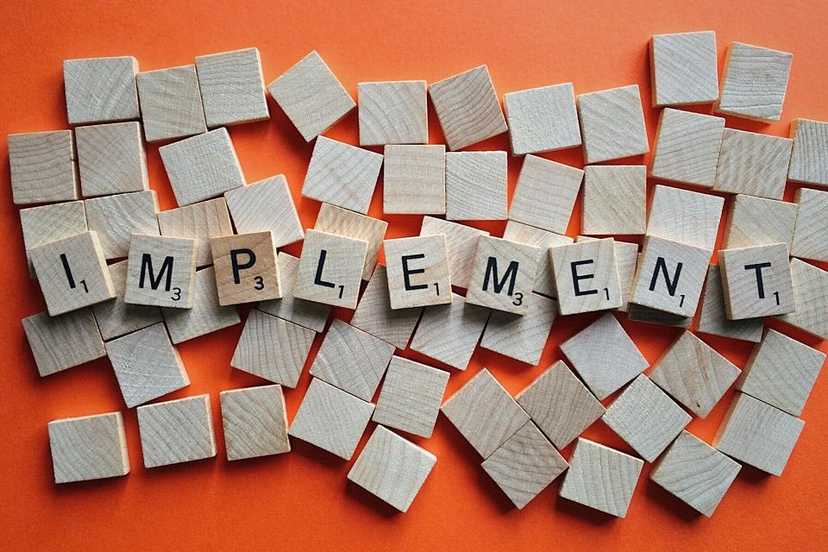
IMPLEMENTATION OF PROJECT
Python implementation of simple face recognition based attendance system using face_recognition library.
A real time face recognition of students and employees for their attendance. The attendance record is stored on a google sheet over the cloud and updates regarding the attendance is directly sent to the user via gmail. An android app is also provided for the end user.

Slide 9
Basic project flow
local db of face and their encodings ------> face recognition--------> mark attendance in gsheets----->email alerts----->android app
Methodology of the system: • Capture a video and check each frame for person. • If any person is detected , detect the face and crop the frame around his face. • Generate facial features of that face and match these with the local database. • If the facial features are matched get the name of the person from the local database. • Get the date and name of the person detected and update the attendance in the google sheet. • Get the email id of the person from the google sheet and send a mail regarding the attendance status.
Methodology for face recognition:
• Capture a video and process each other frame. • Resize the image to 1/4th of the original frame. • Convert the image from BGR to RGB. • generate a 128 byte array of data for each face detected. • Compare this array with the existing arrays in the local database. • Calculate Euclidian distance from each face in the local database and get the index of minimum distance. • Get the name of the best match index.

Slide 10

Conclusion
A face detection and recognition system would certainly speed up the process of checking student attendance in comparison to other biometrics authentication methods and in the right circumstances it would be able to match their accuracy. Nowadays there are a wide variety of software, whether it is a Face API like Microsoft’s or a library like OpenCV, that makes face detection and recognition accessible and reliable and is constantly improving. Each softwareimposes various restrictions, such as the limited number of calls you can make to Microsoft’s Face API. However, using more than one software can reduce these restrictions and lead to better results.

Slide 11


